Slide 1
Heart Attacks
By: Gustavo De Levante

Slide 2
What is a Heart Attack?
“Your heart muscle needs oxygen to survive. A heart attack occurs when the blood flow that brings oxygen to the heart muscle is severely reduced or cut off completely.”
-https://www.heart.org/en/health-topics/heart-attack/about-heart-attacks

Slide 3
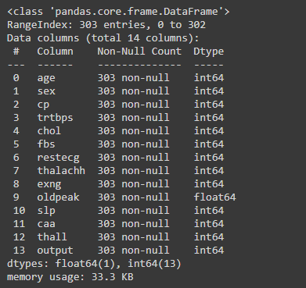
Data Cleaning

Slide 4
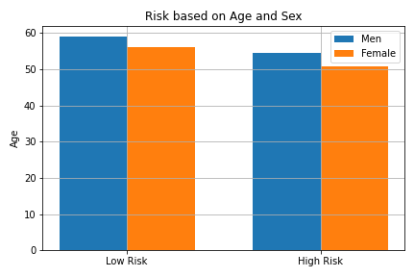
Age
On this data the average male that had a Heart Attack was 55 years old and for the females it was 51 years old. This set of data makes you think that the older the likely but the average age of this data set is 55.

Slide 5
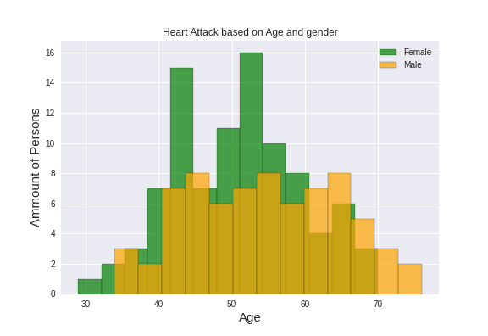
People that got Heart Attacks
Here we can see that the risk for a heart attack increases with age and that for males and females the most risk after 45 years old.

Slide 6
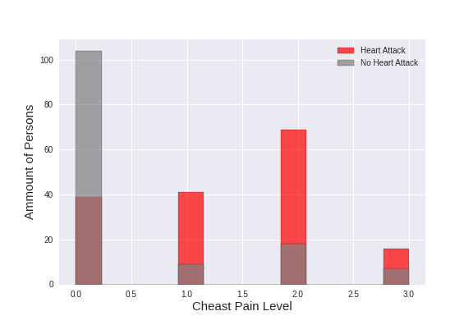
Chest Pain indicating a Heart Attack
Here we can see that based on scale of 1-4 most heart attacks are cause high pain chest and that small amount of pain on the chest is probably not a heart attack.

Slide 7
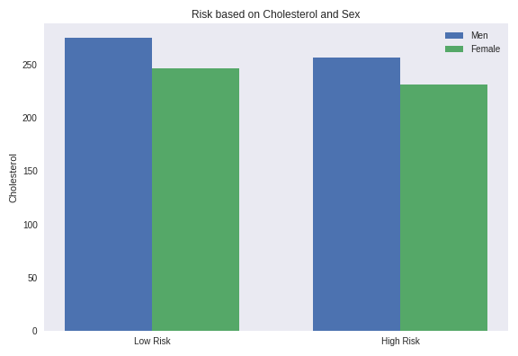
Cholesterol
The average cholesterol levels for a person that had a heart attack for females is 230 mg/dl
And male is 256 mg/dl

Slide 8
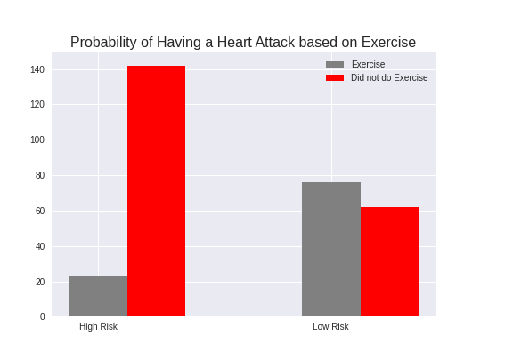
Exercise
86% of the people the people that are on High Risk did not do exercise. 55% of the people are on Low Risk do exercise.

Slide 9
Machine Learning
Logistic Regression
We are trying to determine if the person will have a heart attack.
Training accuracy:87%
Testing accuracy: 81.2%

Slide 10
Conclusion
-Do some Exercise
-Eat Better
-Start going to the Doctor more the older you get.

